Slide 1
Tweeted Trips
A Mashup Analysis
Thomas Johnston

Slide 2
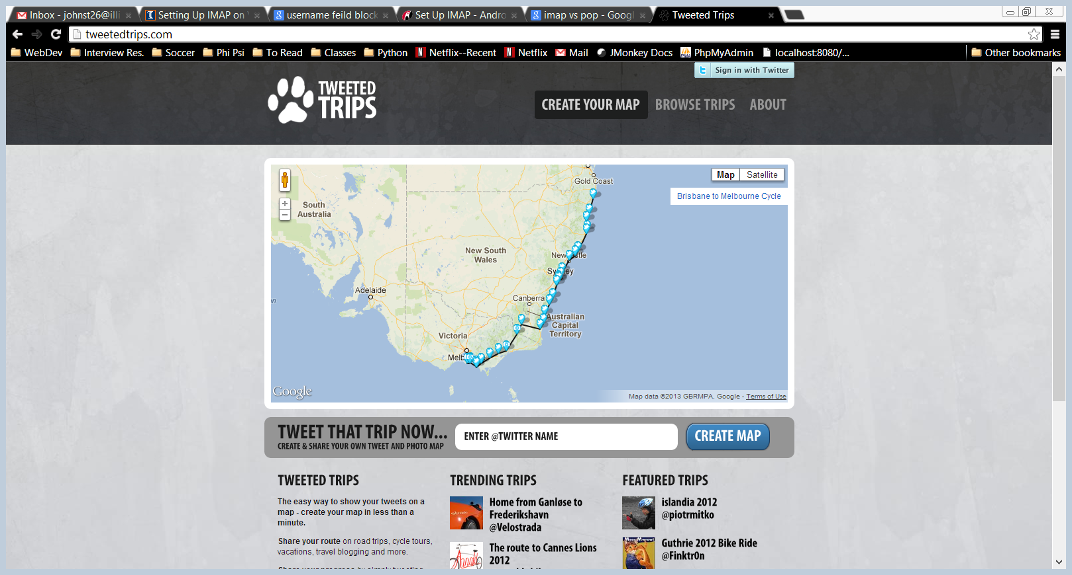
Is project on track for delivery as expected?
What is final date for delivery?
What are final cost estimates?
Status against any other high-level shipping goals
Manufacturing rate
Delivery
Partners, etc.

Slide 3
General Description
Web app that allows people to geo-locate their tweets from a road trip or safari
Pins the Tweets to an interactive Google Maps map.
Uses Twitter and Google Maps API

Slide 4
Details on integration
Uses the Twitter API to retreive tweets content, date/time, and GPS location
Overlays (“mashes”) this data onto an interactive Google Maps map
Backend features PHP or some backend scripting
Also features jQuery and Myriad Pro 700 font.

Slide 5
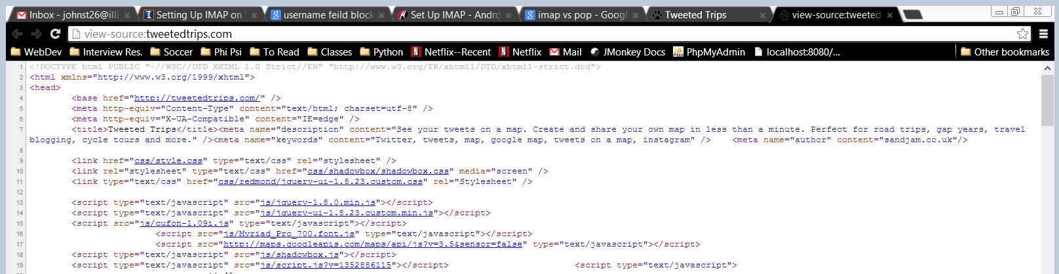
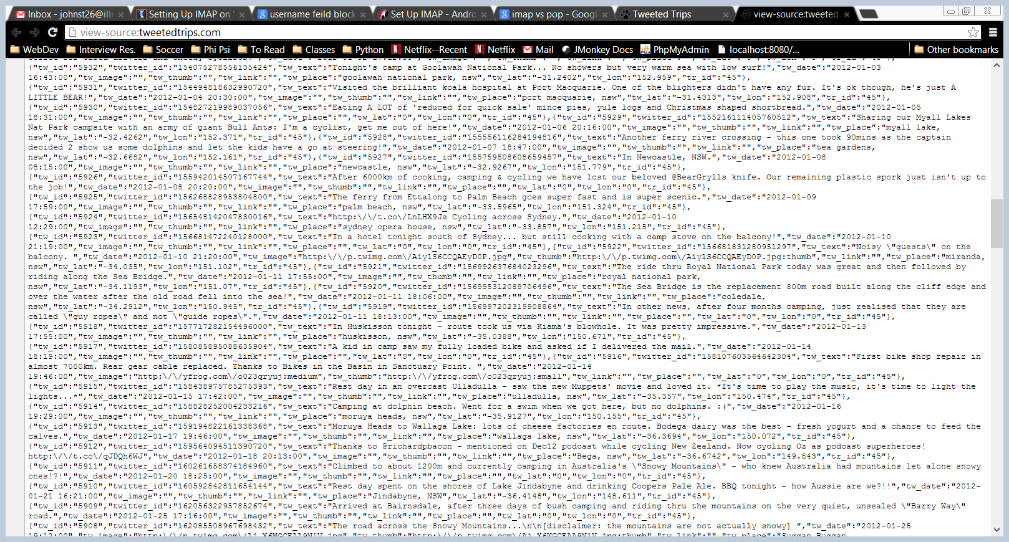
Homepage Analysis
jQuery
Myriad Pro 700 Font
Server-Side (PHP) Generated Code

